Slide 1
Appendix A:
Using Alice
Alice is named in honor of
Lewis Carroll’s Alice in Wonderland

Slide 2
Outline
Part 1: Running virtual worlds
  World 1: A first animation
  World 2
  World 3
Part 2: Using popup menus
  Using methods with object subparts
  Get a good look at an object

Slide 3
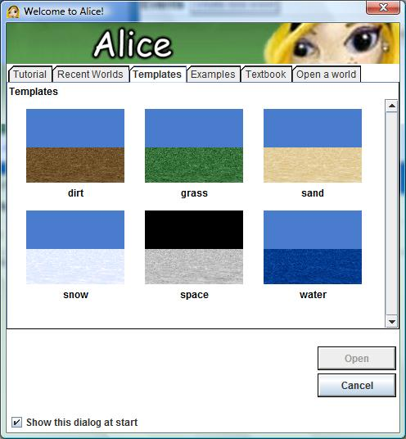
Part 1: Running virtual worlds
Start Alice
Alice may display a choice dialog box

Slide 4
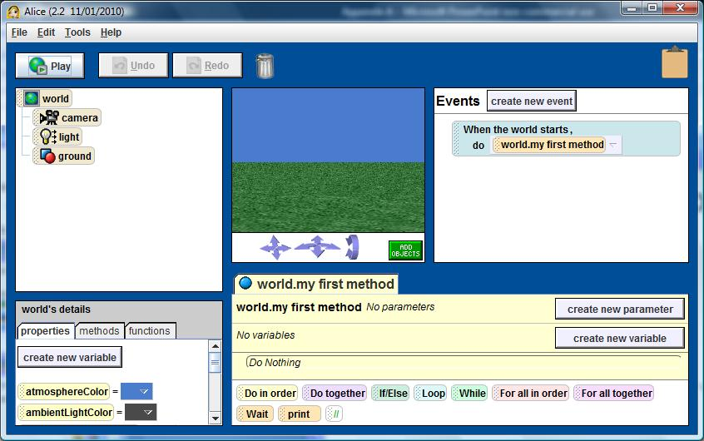
Part 1: Running virtual worlds
Object Tree
World View
The Alice Interface appears
Events Editor
Details Panel
Editor

Slide 5
World 1: A first animation
Open AppendixA_FirstWorld
Play the World:
  Speed
  Pause
  Resume
  Restart
  Stop
  Take a Picture

Slide 6
World 2
Open AppendixA_Dancing Bee
Press the following keys in any other:
  Up arrow key
  Space bar
    This is an interactive, event-driven animation
    Pressing the up arrow key creates an event
    Alice responds to that event by making the hare jump

Slide 7
World 3
Create a New World selecting the snow template for an initial scene
Save World As SnowmanExercise
Add Objects
  Alice opens the Scene Editor:
    Local Gallery
    DVD Gallery
    Web Gallery
  Select Local Gallery/People/Snowman

Slide 8
World 3
Drag the snowman around the scene with the mouse (Undo button)
Check the Mouse Controls buttons
Affect Subparts Checkbox
Add a snowwoman object to the world
Select quad view
  Arrange the objects facing one another

Slide 9
World 3
Object movement
  Ctrl + Mouse: turn an object around in a spinning motion
  Shift + Mouse: move an object up and down
Click and drag on the Camera controls
Setting up a Scene
  Add all objects to the scene upon creating the world
  Use mouse and camera controls to arrange objects in the scene

Slide 10
Part 2: Using popup menus
Alice provides built-in instructions (methods) that can be used to adjust the size and position of objects in a scene
Start a New World
Select Grass template world
Add a happyTree and a frog

Slide 11
Part 2: Using popup menus
In the Object Tree
  Right-click on frog
    Methods
      Frog resize
        2 (twice as big)
      Turn
        Left
          ¼ Revolution

Slide 12
Part 2: Using popup menus
In the Object Tree
  Right-click on happyTree
    Methods
      Roll
        Left
          ¼ Revolution
      Stand up
  Right-click on frog
    Methods
      Turn to face
        happyTree

Slide 13
Using methods with object subparts
Subparts can be manipulated with a method, by clicking on the subpart in the Object Tree and then right-clicking the subpart to get the popup menu
Click the + before frog
  Click the + before head
    Click the + before jaw
      Right-click on tongue
tongue/methods/move/forward/other/.1

Slide 14
Get a good look at an object
Right-click the Object
Camera get a good look at this
If another object is between the camera and the object, and blocks the camera view, use Undo and move the
camera or the object

